Slide 1
Data Compression

Slide 2
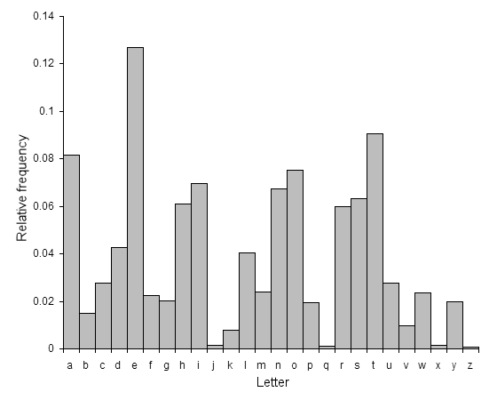
“The Gold-Bug”
53‡‡†305))6*;4826)4‡.)4‡);806*;48†8
¶60))85;1‡(;:‡*8†83(88)5*†;46(;88*96
*?;8)*‡(;485);5*†2:*‡(;4956*2(5*—4)8
¶8*;4069285);)6†8)4‡‡;1(‡9;48081;8:8‡
1;48†85;4)485†528806*81(‡9;48;(88;4
(‡?34;48)4‡;161;:188;‡?;
8=e, 88=ee
;48 = the
;(88= t?ee = tree
188; = ?eet = feet
;46(;88*=t??rtee? =t(hi)rtee(n)
83(88=e?ree =(d)egree
A good glass in the bishop's hostel in the devil's seat
forty-one degrees and thirteen minutes northeast and by north main branch seventh limb east side shoot from the left eye of the death's-head a bee line from the tree through the shot fifty feet out.

Slide 3
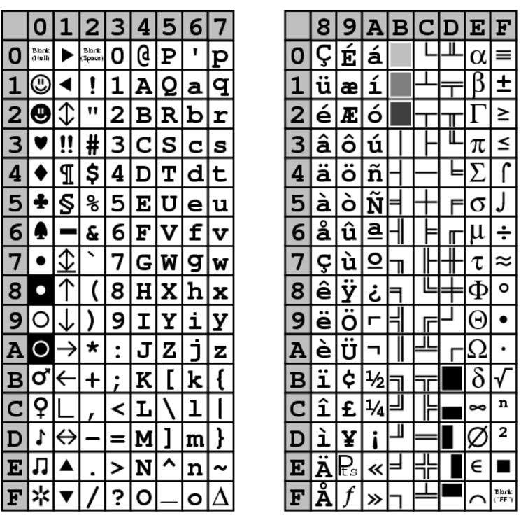
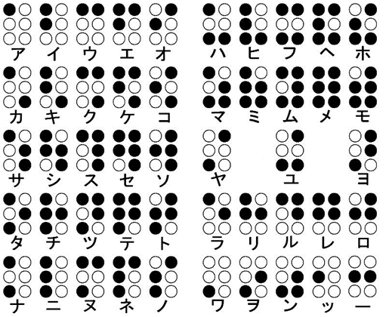
ASCII (American Standard Code for Information Interchange)
1= 00110001
A= 01000001
a =01100001
K= 01001011

Slide 4

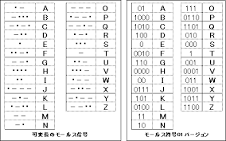
Morse code
Sort characters by frequency
Assign short codes in the sorted order.
Length 1: e and t
Length 2: a, i , o, n (different from the table. WHY?)
Length 3: d, h, l, m, r, s, u, w
Longer codes for special characters, numbers, etc

Slide 5

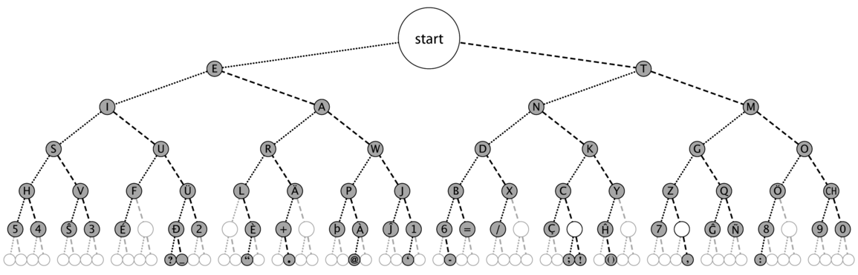

Slide 6
Huffman code
A code without “separator”
  It should be “prefix free”
  Different from Morse code
Assign short code c(p) to frequent character p
  L(p): length of c(p)
  freq(p): frequency of p
Minimize the summation of freq(p)L(p) over all p
  How to find such a code?
Huffman code
  A greedy algorithm gives the solution (it is surprising)
  Theoretical the best “character code”

Slide 7
Huffman code and tree
0
1
e
f
0
1
0
1
a
b
c
d
A code is represented by a rooted binary tree
  If c(a) = 00, c(b)= 01, c(c)= 10, c(d)= 11, c(e)=0, c(f)=1
  Prefix-free code: codes are assigned only for leaves
  c(a)=000, c(b)=001, c(c)=010, c(d)=011, c(e)=10, c(f)=11
e
f
a
b
c
d

Slide 8
Construction of a Huffman code using a tree
freq(a)= 9, freq(b)=1, freq(c)=2, freq(d)= 12, frq(e)=40, freq(f)=8, freq(g)=17, freq(h)= 7 (in percent)
Find the smallest frequency pair, and unite
  b and c, freq(b+c)= 3
  b+c and h, freq((b+c)+h)=10
  a and f , freq(a+f)= 17
  (b+c)+h and d, freq(((b+c)+ h)+ d) = 22
  g and (a+f), freq (g+(a+f))= 34
  g+(a+f) and ((b+c)+ h)+ d)
  freq((g+(a+f)) + (((b+c)+ h)+ d)) = 56
  Finally, e and the above one
c(a)= 0000, c(e)= 1
What is c(b) and c(d)?
((g+(a+f)) + (((b+c)+ h)+ d))
e
g+(a+f)
((b+c)+ h)+ d
a+f
(b+c)+ h
g
d
a
f
h
b
c

Slide 9
Exercise
Make a Huffman code for the following frequency
freq(a)= 5, freq(b)=1, freq(c)=2, freq(d)= 12, frq(e)=25, freq(f)=6, freq(g)=14, freq(h)= 7 (in percent)

Slide 10
Extension of Huffman code
What is the way to “disable” the (naïve) frequency analysis?
  Assign a new code to frequent words
    “the” should be replaced by a new symbol
Same for the “short code”
  Give codes to frequent words
  Give codes to k-gram (length k words) that frequently appear.
    th, to, er, re, an, th, is,of, es….
    More frequent than q
Defect of Huffman code
  The dictionary size tends to be large if we consider long words
  We need to compute the frequency to make the dictionary
  Not powerful for short documents or special sequences

Slide 11
LZV compression (bzip)
Use a part (say, D) of the document T as the dictionary
The subsequence S of T is replaced by ( l(S), p(S)), where p(S) is the position of appearance of S in D, and l(S) is the length of S.
Example D = ACGTTACCGTCGGATAAATGCTA
T= ACGGGATCGTACAAATACGGATCGAAAT
= ACG GGAT CGTA C AAAT CGGAT CG AAAT
E(T)= (3,1)(4,12)(4, 20)(1,2)(4,15)(5,11)(2,2)(4,15)
The dictionary part is updated (shifted as we read the document
How to encode and decode?
  Suffix array data structure

Slide 12
Sructures and computation
(x-y) (x² + xy + y²) = ??
1 + 2 + 3+ … + n = ?
How many combination of 6 elements from 10 elements
  Can you list up all of them??
How many s-t paths in an n × n grid?
  How many “monotone” paths?
  Can we list up all paths?
  Fukashigi Onesan
How many “spanning trees” in a graph
  How many spanning trees of a complete graph K_{n}?
  Can we list up all spanning trees?
How many ways to fill 1 ×2 dominos in a grid?
  Can we list up all patterns?
How many independent sets in a graph (say, a cycle of length 6)
  The location of red beads in a necklace without adjacent red beads
  How many maximal independent sets?
  Can we find an independent set with the maximum size?
Question: Suitable for high school, university, Ph.D, programming contest?
s
1
2
1
3
4
5
3
6
7
t
2
4
1
2
1
2
6
3
6
3
5
4
5
4

Slide 13
Decision diagram
A way to list up all possible binary functions (or combinations)
Binary function → Set of binary vectors → family of subsets of a set
f (x,y,z) = x+y+z → f(x,y,z)= 0 : (0,0,0), (1,1,0),(1,0,1),(0,1,1)
→ ∅, {a,b}, {a,c}, {b,c}: subset of {a,b,c}
Binary function f can be represented as a binary code, thus also as a binary tree, named binary decision tree.
Drawback: The tree has 2^{n} leaves
x
0
1
y
y
z
z
z
z
0
1
1
0
1
0
0
1

Slide 14
BDD (Bounded Decision Diagram)
A compact way to list up all possible binary functions
f (x,y,z) = x+y+z (f = 0 has four solutions)
x
0
1
y
y
z
z
z
z
x
x
1
0
1
1
0
0
0
1
0
1
0
1
y
y
y
y
z
z
z
z
0
1
1
0
0
1

Slide 15
BDD (Bounded Decision Diagram)
Another rule: Skipping irrelevant variables
x
0
1
y
y
z
z
z
z
x
x
1
0
1
0
1
1
0
1
0
1
0
1
y
y
y
z
z
z
0
1
0
0
0
1

Slide 16
How to represent a set of structures?
Given a graph (say, a cycle of size 6)
Report all maximal independent set
  How many?
  If we use binary decision tree, it will have 64 leaves
Your exercise
  Construct BDD for the set of independent sets of the above graph
  Count the number of all independent sets
  Construct BDD for the set of maximal independent sets
1
2
6
3
5
4

Slide 17
ZDD: Zero- suppressed decision diagram
If node k has a branch to node k+j in ZDD representing a function f,
f(a₁,a₂,…a_{k}, x_{k+1}, x_{k+2},…,x_{k+j},….) is false (that is, f=0) unless x_{k+1}=x_{k+2}=..=x_{k+j-1}= 0
  Very good representation to represent comparatively small subsets of a large set.
    E. g., The set of shortest paths in a 10 x 10 grid (there are 180 edges, but each shortest path has 18 edges)
    The set of “association rules” in data mining
      Good combinations of sales items among 10,000 sales item of Walmart.
    The set of all subsets of size 2 in {1,2,3,4,5}
  Exercise
    Compute ZDD of all independent sets of the cycle of length 6.
1
2
2
131
3
4
4
5
1
0

Slide 18
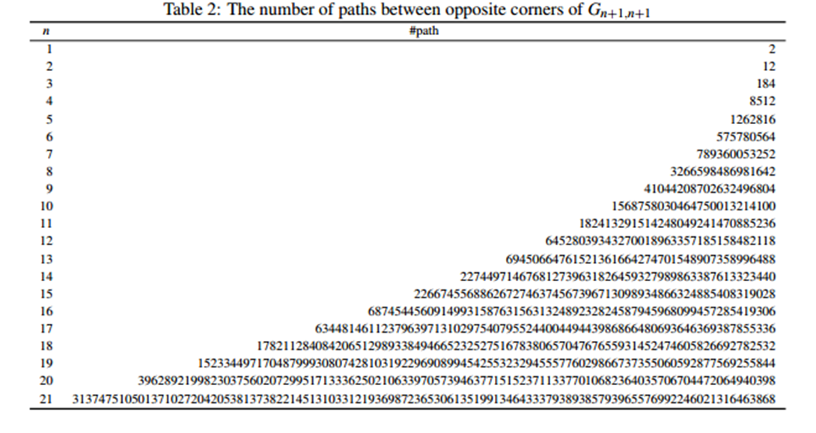
Gigantic data compression possible?
Can we store ultra huge data with powerful compression?
  Yes, if the data has a structure

Slide 19
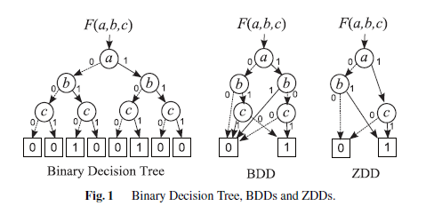
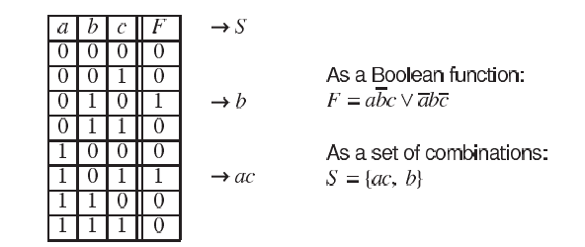
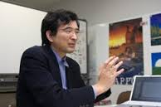
BDD and ZDD: Compressed structures to represent a set of combinations
BDD: Bounded Decision Diagram (Bryant 1986)
ZDD: Zero-Suppressed Decision Diagram (Minato 1993)
Figures from a survey by S. Minato (2013, IEICE Trans.)
Techniques of BDD/ZDD: Brief History and Recent Activities
They represent a data as the set of directed paths in a directed acyclic graph.
ZDD is often much better in data analysis, since ZDD considers combinations while BDD considers Boolean formulae
Shinichi Minato, Hokkaido U.

Slide 20
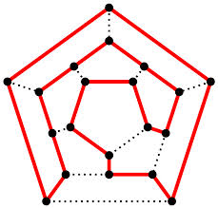
Compression of structured data
X(G): set of of all paths from s to t going through all nodes in a given graph G (Hamilton paths)
Question: What is the cardinality |X(G)| of X (G)
Difficult, since “|X(G)| = 0 ?” is intractable.
A naïve approach: Generate X (G) and count.
Foolish! Since
|X(G)| ≒ 2.27 * 10 ⁴⁷ if G is a grid of 15 × 15.
However, the “information entropy” of X(G) is very small, just
P(G) = “The set X(G) of all paths from s to t going through all nodes in G”
Can we apply data compression? P(G) is smaller by a factor of 10 ⁴⁵
We need to compress the data into Y(X(G)) so that it is easy to use and constructed without generating X(G).
s
t
P(G)
×
X(G)
Y(X(G))

Slide 21
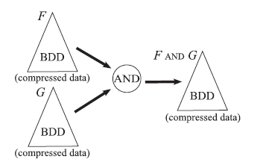
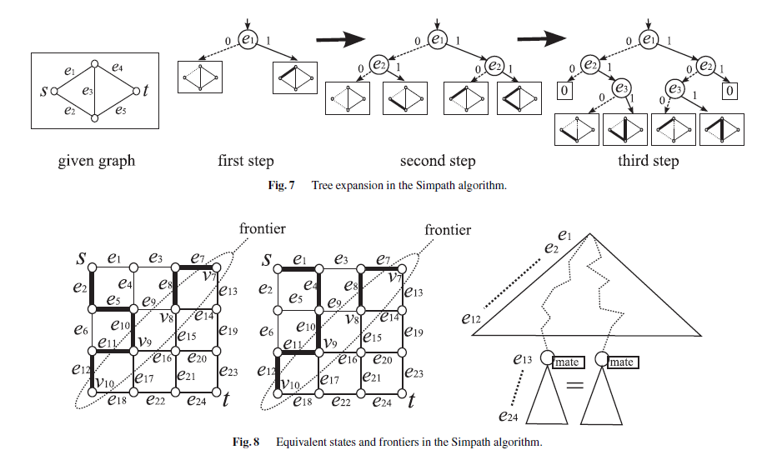
Properties of BDD/ZDD
Easy to query and count.
Boolean operations can be applied
Constructed in compressed forms

Slide 22

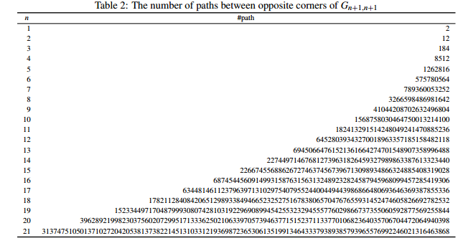
Power of ZDD
The set of all Hamiltonian paths in a 15 x 15 grid is given as ZDD with 144,759,636 nodes. It takes a few minutes for construction.
With sophisticated construction algorithms , 21 x 21 grid can be handled, where |X(G)) ≒ 3*10 ¹⁰⁷
From a technical report of Iwashita-Kawahara-Minato, 2012.

Slide 23
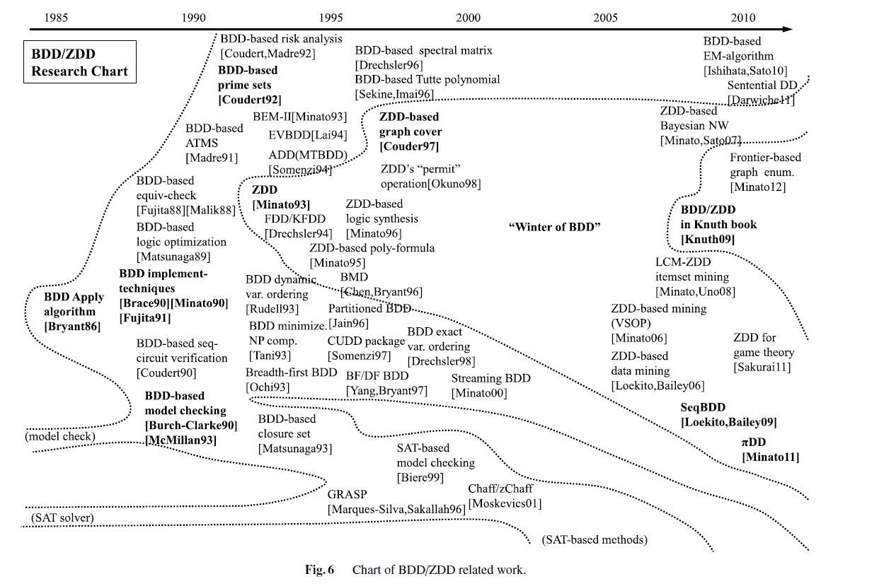
Research on BDD and ZDD

Slide 24
Applications (1): Data Mining
Association rule of a data
Lemonade = yes and SoapA = yes → Mineral water = yes
Frequent Item Set: {A, B, C,…} such that there are sufficient number of data (support) satisfying A= yes, B= yes, and C= yes,…

Slide 25
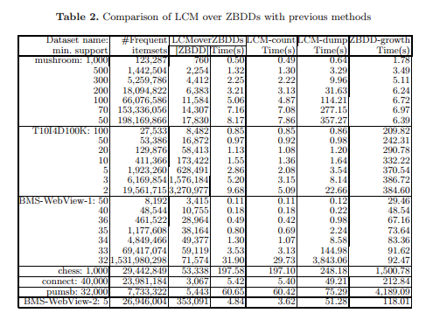
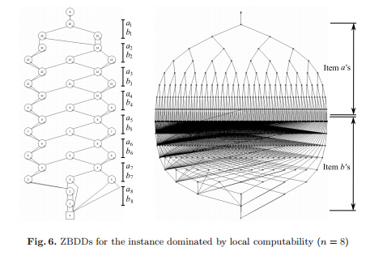


Finding all frequent Item sets
Frequent item set S is a subset of the set U of all attributes.
  If |U| = 100, there may be 2 ¹⁰⁰ subsets.
  If S is a frequent item set, all subsets of S must be frequent item sets.
Suitable to be computed and stored using ZDD
Minato-Uno-Arimura, LCM over ZBDDs: Fast generation of very large-scale frequent itemsets using a compressed graph-based representation: 2008

Slide 26
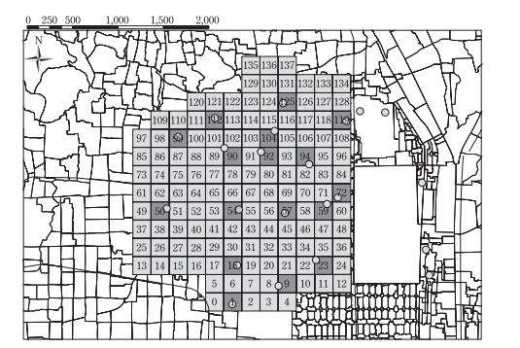
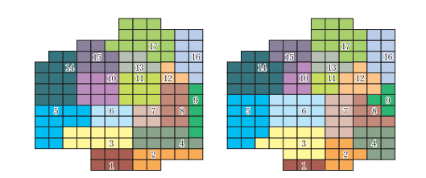

Applications (2)
Evacuation planning
  Enumerating all possible assignment of people for the emergency situation
  Once emergency really happens, report only available plans
  User can select suitable solution
A. Takizawa, Applying Discrete Algorithms to Evacuation Planning Problems (2014)
Atsushi Takizawa, Osaka Prefecture U.

Slide 27
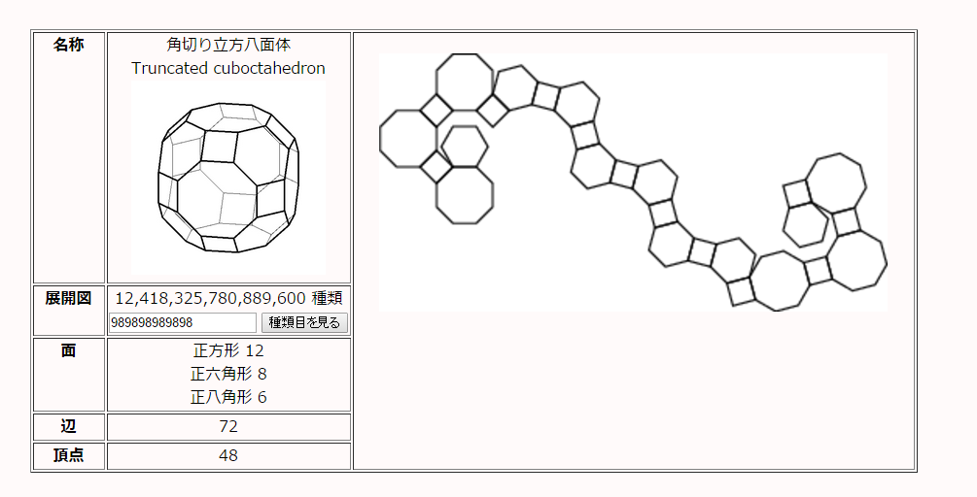
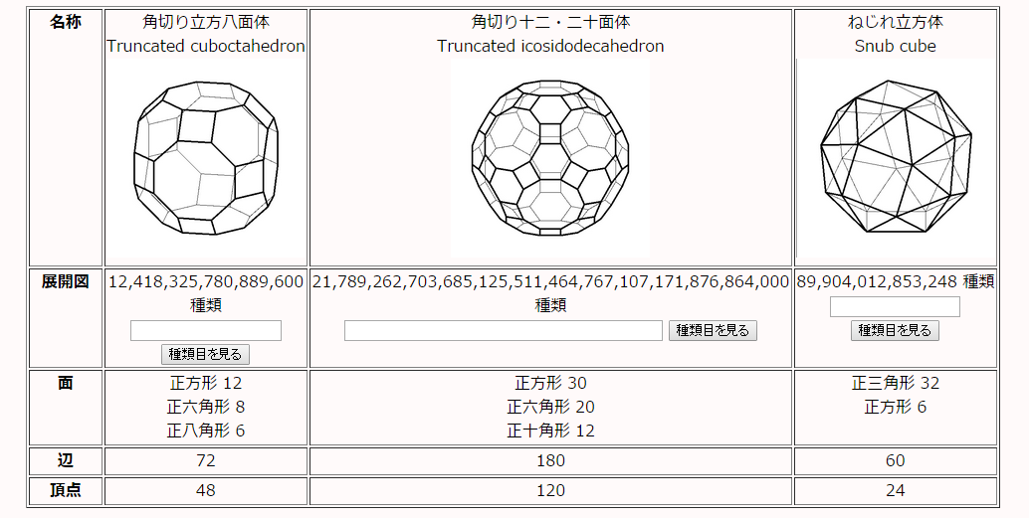
Application (3)
Enumerating Geometric Structures
  Enumerating unfoldings
  Applications to chemistry etc.

Slide 28
Application (3)
Enumerating Geometric Structures
  Enumerating unfoldings
  Applications to chemistry etc.

Slide 29
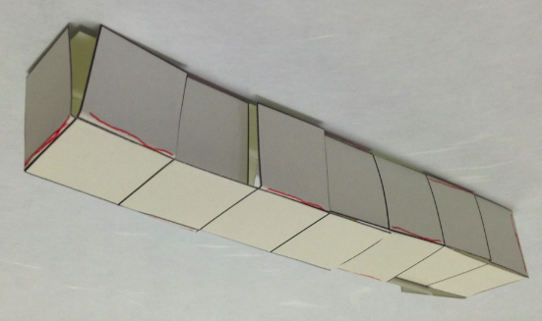
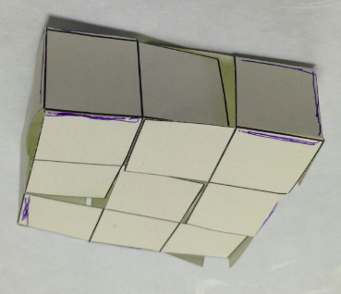

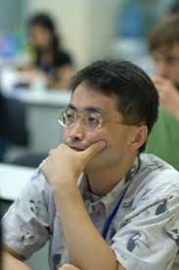
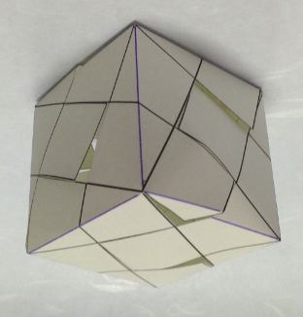
Using the logical operation of ZDD
Shared unfolding of geometric objects
Art: Enumeration of tiling patterns animation.pdf
1x1x7
1x3x3
?
Yoshiaki Araki, Takashi Horiyama, Ryuhei Uehara:
Common Unfolding of Regular Tetrahedron and Johnson-Zalgaller Solid. WALCOM 2015: 294-305
√5x√5x√5

Slide 30
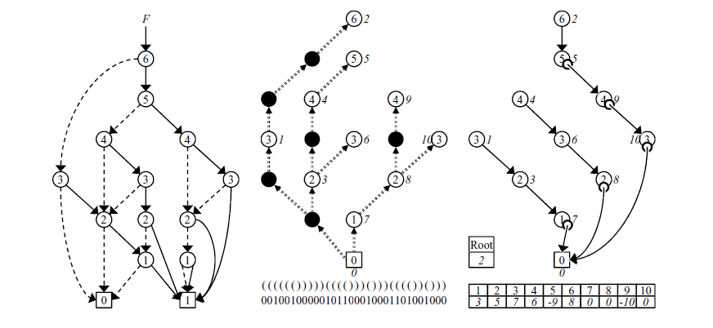
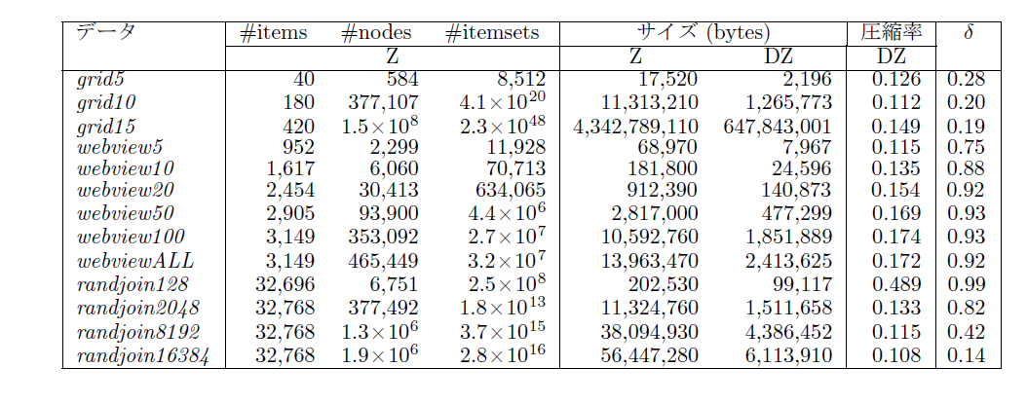
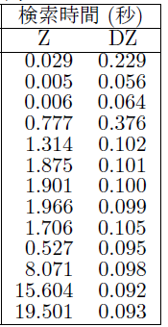
Dense ZDD
Further compression
fast query
Combined with CRAM technique
Sadakane et al., 2015

Slide 31
Beauty of computation
s
1
2
1
3
4
(x-y) (x² + xy + y²) = ??
1 + 2 + 3+ … + n = ?
How many combination of 6 elements from 10 elements
How many s-t paths in an n × n grid?
  How many “monotone” paths?
How many “spanning trees” in a graph
How many ways to fill 1 ×2 dominos in a grid
How many independent sets in a path of length n?
How many independent sets in a cycle?
5
3
6
7
t
2
4
1
2
1
2
6
3
6
3
5
4
5
4

